Slide 1
Board Chair Report
September 2, 2021

Slide 2
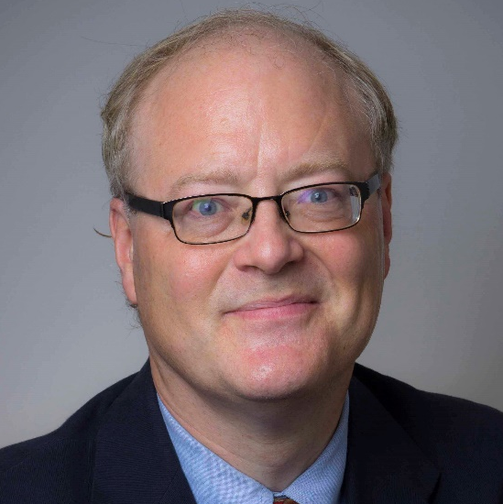
Curators’ Distinguished Professors
Sara Dallas, Ph.D.
School of Dentistry
Larson Powell, Ph.D.
Film Studies

Slide 3
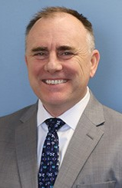
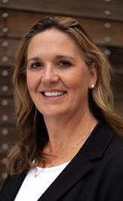
Dr. George Gotto and Dr. Michelle Reynolds, Institute for Human Development
Dr. George Gotto, Director
Dr. Michelle Reynolds, Senior Associate Director
Expertise: The UMKC-IHD is an applied research and training center for human services and serves as a bridge between the university and community. The UMKC-IHD partners with several state agencies.
Funding: UMKC-IHD has 59 actively funded grants from 27 sources for a total of $6.1 million.
Dr. Gotto
Dr. Reynolds

Slide 4
Dr. Chenglin Wu, Engineering
Associate professor of structural engineering
Expertise: two-dimensional metals for use in computer chips, sensors and coatings.
Funding: Research has been supported by the NSF CAREER award

Slide 5
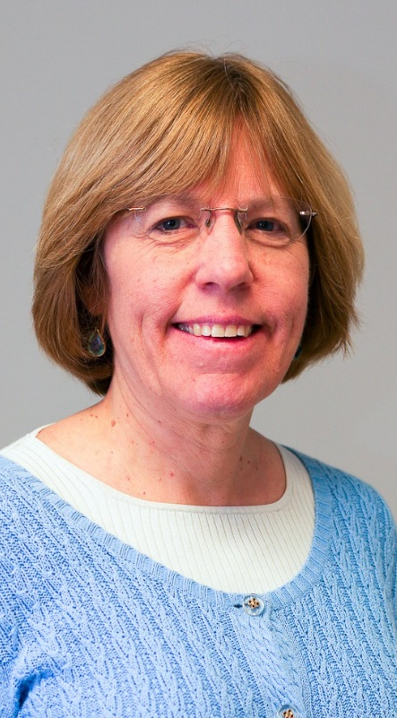
Katie Ellison and Dr. Elizabeth Sale, MIMH
Katie Ellison, Project Director, Gun Suicide Prevention Planning Project
Elizabeth Sale, Primary Investigator, Gun Suicide Prevention Planning Project
Expertise: The MIMH is working to reduce the availability of guns for people with suicidal ideation or substance use disorder. The Gun Suicide Prevention Planning Project aims to build a coalition to focus on mental health and suicide prevent.
Funding: Project is funded by the Missouri Foundation for Health
Katie Ellison
Elizabeth Sale

Slide 6
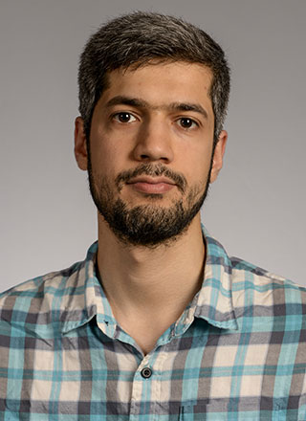
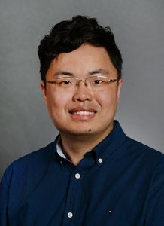
Dr. Hussein Nassar, College of Engineering
Assistant professor in the Department of Mechanical and Aerospace Engineering
Expertise: the connections between elasticity and geometry, structures and mechanisms, in solid mechanics and on related applications in the design and modeling of lattices and architected materials
Funding: NSF CAREER Award
Dr. Zheng Yan, College of Engineering
Associate professor in the Department of Biomedical, Biological & Chemical Engineering and Department of Mechanical & Aerospace Engineering
Expertise: fundamental materials, devices, and manufacturing innovations of soft electronics for health and robotics
Funding: NSF CAREER Award

